Slide 1

I Recruit Hackers
My journey into Infosec, how recruiting works and what matters.

Slide 2
Engagement : Talk Outline
Introduction: /whoami /ipconfig all
My path into infosec: I recruit hackers, therefore I am...
Your entry into Infosec: “To know the next step, one must understand the last step”
What matters?: Resumes, Linked In, CERTS and degrees (Prepare for ambiguity)
Your career: Short term vs Long Term Career decisions
Tips/Summary: As it says on the tin
Questions: Hopefully plenty!

Slide 3
I Recruit Hackers
Introduction
/whoami /ipconfig all

Slide 4
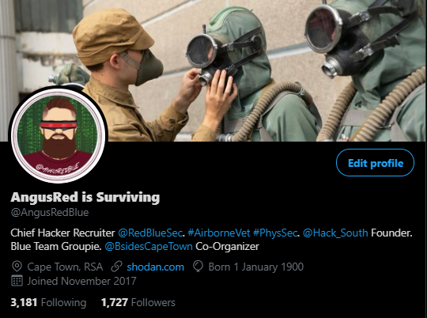

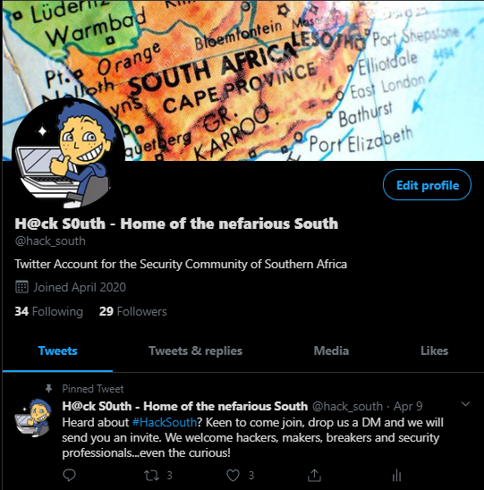
Introduction – $ career/ ls -a
Charles H Wroth
*6 Years: Former British Airborne (3 PARA) UK
-2 Years as a machine gunner
-4 Years as a signals detachment cmdr
*6 Years :High Risk Security Advisor (PhysSec)
-O&G
-Mining and Minerals
-Anti-Piracy
-HECPO
-Coxswain
-Team Medic
*3 Years: Technical Security Recruiter
-Technically advanced security hiring (USA, UK, RSA)
-B Sides Cape Town Co-Organizer (Logistics)
-Shell Con Raise Me mentor
-TMHC Chief Shitposter/Destroyer of Dreams (Recently MOD)
-Working to become a DFIR Consultant

Slide 5

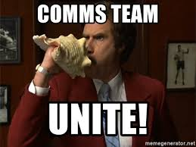



Slide 6
I Recruit Hackers
My path into infosec
I recruit hackers, therefore I am...

Slide 7
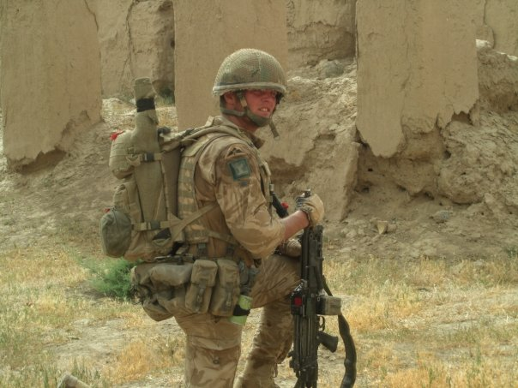

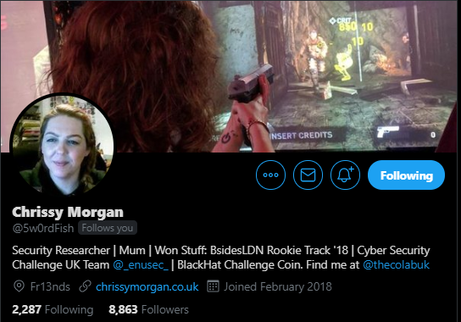
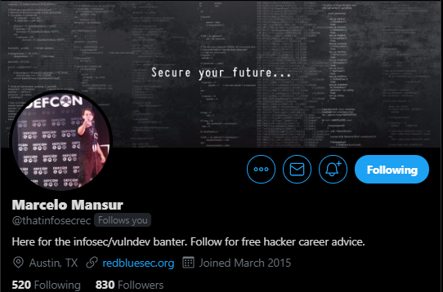




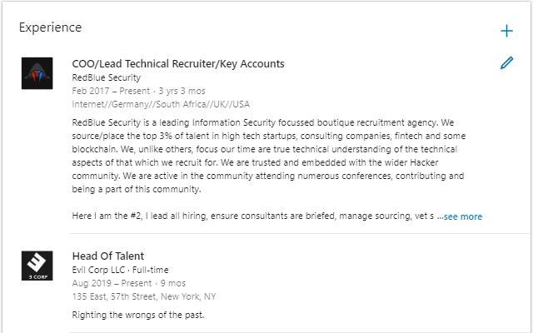
My path into Infosec?

Slide 8
I Recruit Hackers
Your entry into Infosec
“To know the next step, one must understand the last step”

Slide 9
Your entry into infosec? Examples seen
*NO SINGLE PROVEN ROUTE INTO SECURITY
*NO SINGLE PROVEN ROUTE INTO SECURITY
*NO SINGLE PROVEN ROUTE INTO SECURITY
*NO SINGLE PROVEN ROUTE INTO SECURITY
*NO SINGLE PROVEN ROUTE INTO SECURITY
*NO SINGLE PROVEN ROUTE INTO SECURITY
*NO SINGLE PROVEN ROUTE INTO SECURITY
*NO SINGLE PROVEN ROUTE INTO SECURITY*NO SINGLE PROVEN ROUTE INTO SECURITY*NO SINGLE PROVEN ROUTE INTO SECURITY*NO SINGLE PROVEN ROUTE INTO SECURITY*NO SINGLE PROVEN ROUTE INTO SECURITY*NO SINGLE PROVEN ROUTE INTO SECURITY*NO SINGLE PROVEN ROUTE INTO SECURITY*NO SINGLE PROVEN ROUTE INTO SECURITY*NO SINGLE PROVEN ROUTE INTO SECURITY*NO SINGLE PROVEN ROUTE INTO SECURITY*NO SINGLE PROVEN ROUTE INTO SECURITY*NO SINGLE PROVEN ROUTE INTO SECURITY*NO SINGLE PROVEN ROUTE INTO SECURITY*NO SINGLE PROVEN ROUTE INTO SECURITY*NO SINGLE PROVEN ROUTE INTO SECURITY*NO SINGLE PROVEN ROUTE INTO SECURITY*NO SINGLE PROVEN ROUTE INTO SECURITY*NO SINGLE PROVEN ROUTE INTO SECURITY*NO SINGLE PROVEN ROUTE INTO SECURITY*NO SINGLE PROVEN ROUTE INTO SECURITY*NO SINGLE PROVEN ROUTE INTO SECURITY*NO SINGLE PROVEN ROUTE INTO SECURITY*NO SINGLE PROVEN ROUTE INTO SECURITY*NO SINGLE PROVEN ROUTE INTO SECURITY*NO SINGLE PROVEN ROUTE INTO SECURITY*NO SINGLE PROVEN ROUTE INTO SECURITY
Etc

Slide 10
Your entry into infosec? Real
Root/s
University Route
Had an interest in tech/computers
Signed up and studied CS
Find Hacker Meetup/CTF
Get the taste
Change Major
Get internship
Go full-time
PROFIT
Gamer Route
Avid gamer as a teen
Wants to be the best
Finds cheat codes
Wants more
Learns about scripting, builds scripts
Finds the hacker community
PROFIT

Slide 11
Your entry into infosec? Continued
Root/s
Hacktivism/Justice/Taking a Stand
Living your best life
Something upset you
Wanted to do something about it
Find other people that want to do something about it
Learns to do something about it
Does something about it
Gets away with it
Learns through the process that you can do it professionally
PROFIT
Influence/Curiosity
Parent/Friend/Article
Curious nature
Research at mass
Builds small skills
Finds the community (TMHC, Hack South, B Sides etc etc)
Gets involved
PROFIT

Slide 12
Your entry into infosec? Continued
Root/s
Reroll
Working a non-security related role (General IT, Development)
Working a less security centric role (SysAdm, Helpdesk, Pre-sales eng)
Get introduced to security
Upskill/Retrain
Get your first security gig
Ride the wave
PROFIT
Linear
Young
Growing up involved in community/security
Solid skills by 18
Goes to Uni studying security/completes courses in security
Completes/Graduation
Junior > Mid > Senior > …….
PROFIT

Slide 13
Your entry into infosec? Advice
You already have the first step right!
Find your community (TMHC, Hack South, B Sides, HTB, Together We Hack, Darknet Diaries Discord)
Tell others about the community
Get them involved!
Grow your involvement with the community
Volunteer at local con/meetup
Help those less experienced than you
When you get to the top floor, send the elevator down
Start your own community locally
Don’t be shy!
We are all weirdos
We all have our insecurities
You will most likely “Find your people
Upskill
Take advantage of free training
ABL: Always be learning
If you get the opportunity to do a course/training, do it!

Slide 14
Your entry into infosec: Summary
There is no 1 way to get into Infosec
Tell them of us!
Don’t be evil
Help someone less experienced than you and learn from those more experienced
Become part of the conversation, part of the community
Get involved
Volunteering
CFP
CTF
Organizer
ABL!!!!

Slide 15
I Recruit Hackers
What matters?
Resumes, Linked In, CERTS and degrees (Prepare for ambiguity)

Slide 16



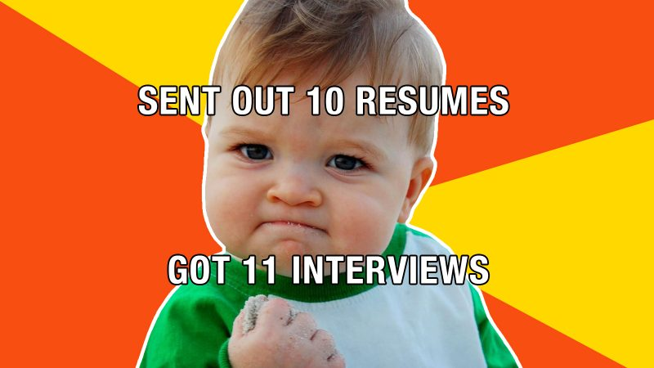
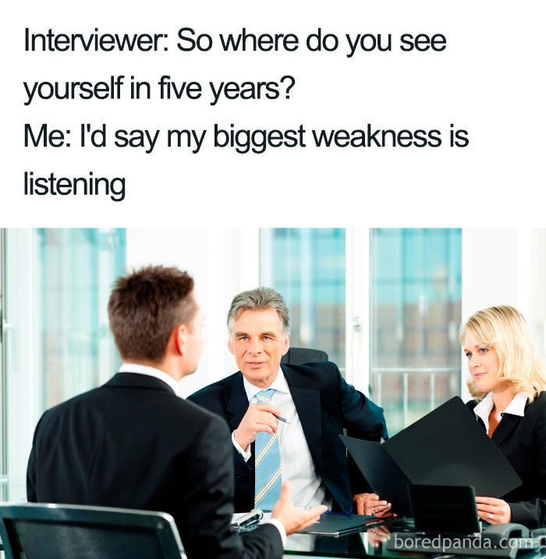
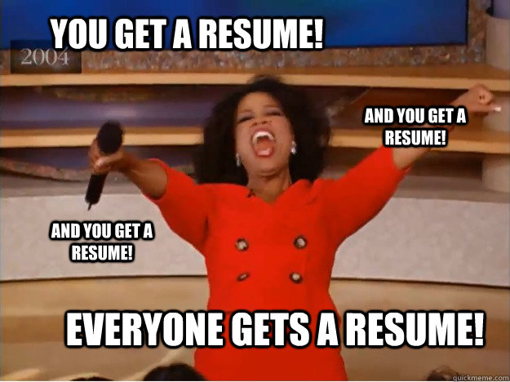
What matters?
Subjects:
Resume
Linked In
Applications
Interviews
Tech Tests
Closing
Twitter
CERTS and Education
**Warning: I will mix/match**

Slide 17
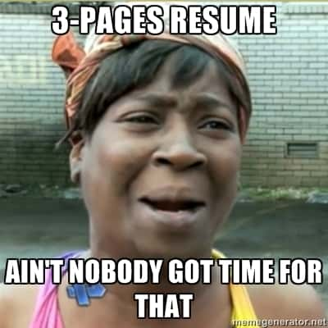
What Matters: Resumes/Curriculum Vitae/CV
First step in the process
Time on target
“Resumes are in the eye of the beholder”
1 Page is great, 2 is fine (Most common), 3 is not, 4+ is North Korea
Community Engagement
It’s a working document (Repeat after me!)
If in doubt, read the screen
Photo
Personal information/OpSec/PerSec
Layout
Colour/Color
What’s there to talk about?
Dot “i’s”, cross “t’s”
Long service breakdown
10+ years legacy
Notes:
Time on Target: About how little time on review a resume. Eye of beholder: No 1 perfect resume Community Engagement: One of Us, commonality, birds of a feather. CONVERSATION STARTER Working Document: Once per month If in doubt, read the Screen: Read your CV, get someone with good grammar to read it it. Spelling and grammar cut first Photo: 1 more layer to critique you on Summary: Where did you come from, what are you doing, what are planning to do in the future. PerSEC: Include what is needed, don’t include EVERYTHING. Town, State, number, email LI, GITHUB/Blog LAYOUT: Use a layout that looks good. Colour: Use colour Whats there to talk about? Don’t include EVERYTHING, leave something to discuss on a call Dot and Cross: Bullets, spelling and grammar How to Display: NEXT SLIDE

Slide 18
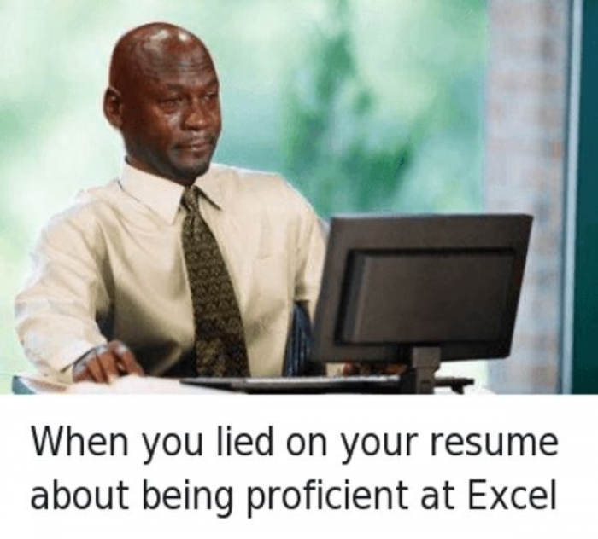
What Matters: Resumes/Technical
Summary (On your resume)
Where did you come from (Technical)
What are you doing now?
What do you want to be doing in the future?
When do I work on my resume?
L33T HAX0R
How to display technical abilities to a non-security, non-technical recruiter?
Technical Table:
Pentesting | nmap, Metasploit, usbrip, Kali Linux, WiFi, Networks, HexEditor, Onyx, Picachu
Virtualization | VM Ware Enterprise, AWS, GCP, GCP to AWS Migration, Kali Linux, Arch Linux, Furry, EKS
Scripting/Coding | C, C++, Python (Advanced), GoLang (Read), GARLang, Javascript
Defense | IDS/IPS, Splunk Certified, Bluecoat, SOC Analysis, Elastic
Networking | IP/TCP, UDP, FTP, BGP, EIGRP
Notes:
When work on Resume: Once a month. Never know. Redundency after comfort Business Owner Dream job could be missed
LEET: You are good, you know you are good, or others tell you are good. Display good, BUT DON’T OVERSTATE your ability. You will get caught out, and it will be embarresing and it will be remembered by you (Ego shot), your recruiter (Wont rep again), employer (Will avoid for years to come)
ONCE A CHEATER, ALWAYS
Found some FIRE Memes on resumes, so see next

Slide 19
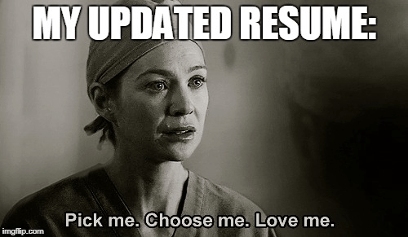
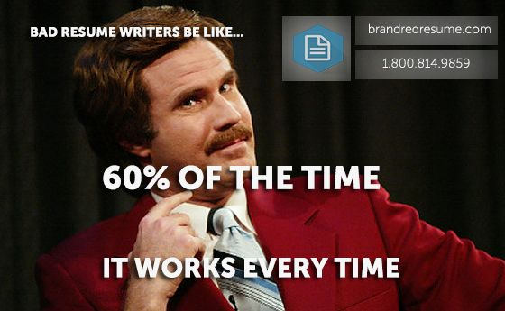
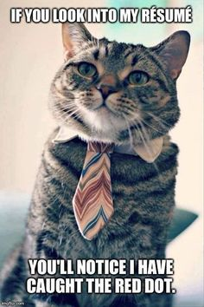
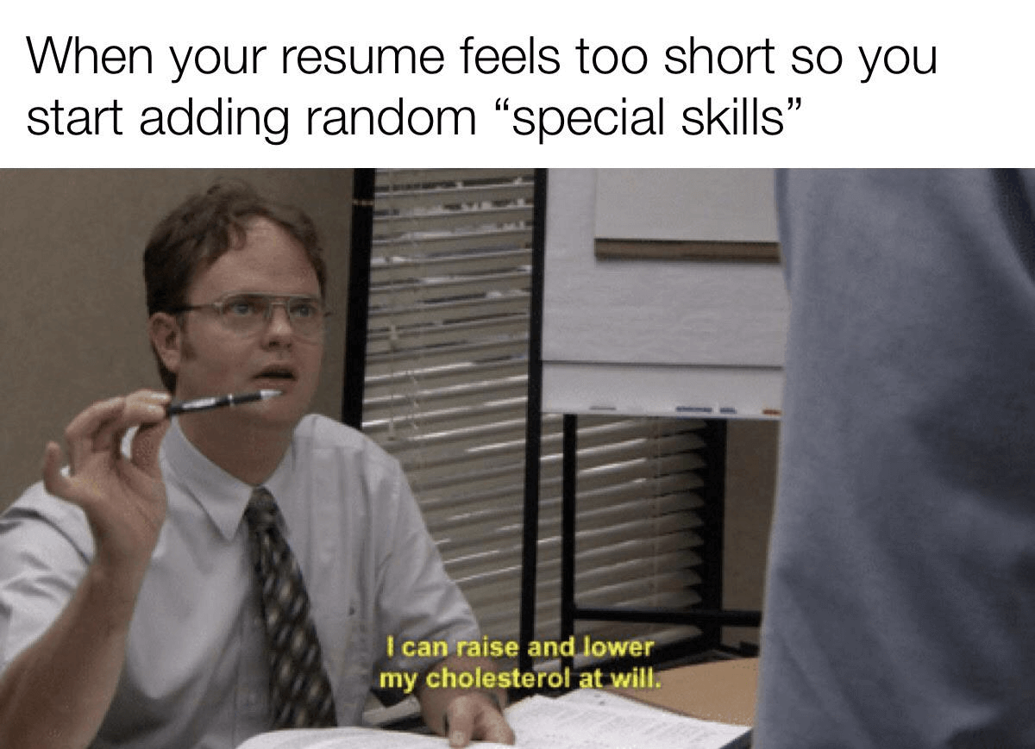
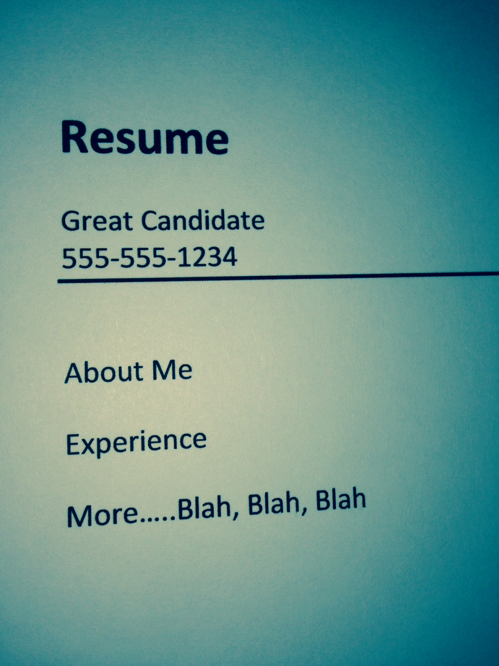
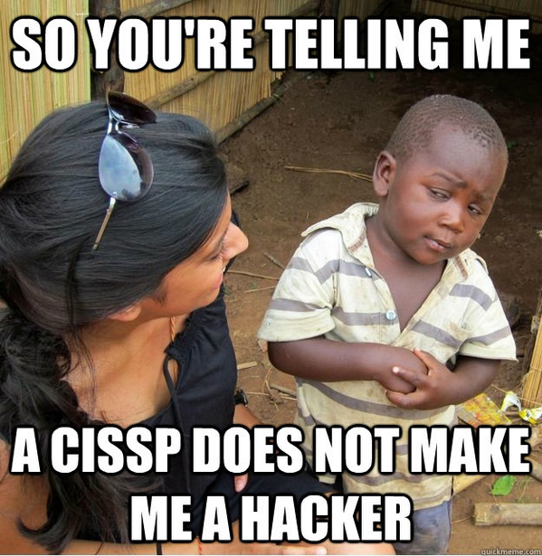
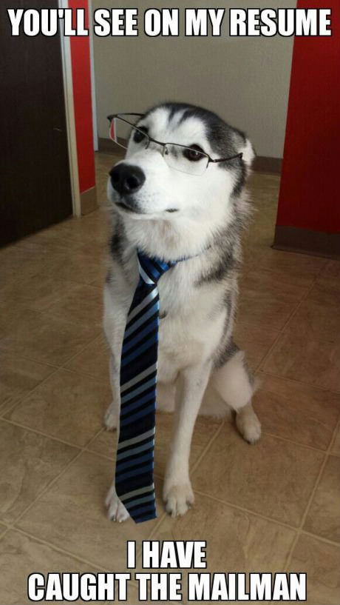
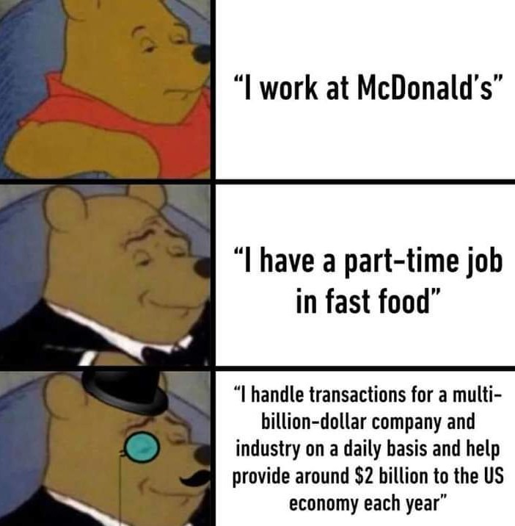
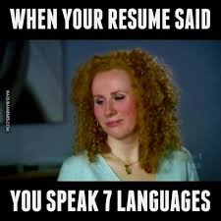

Slide 20

What Matters: Linked In
Summary
Use your LI summary as a 2-3 paragraph resume
Who you are, what your skill-set strengths are
Community engagement
Job Experience
List the company you are working for
Give info about the company
Give info about what your responsibilities are/were
Recommendations
Ask for recommendations
Parents
Line Managers
Team Mates
Clients
Skills
Is there value, and how?
What a recruiter sees??
Notes:
What a recruiter sees? NEXT SLIDE

Slide 21
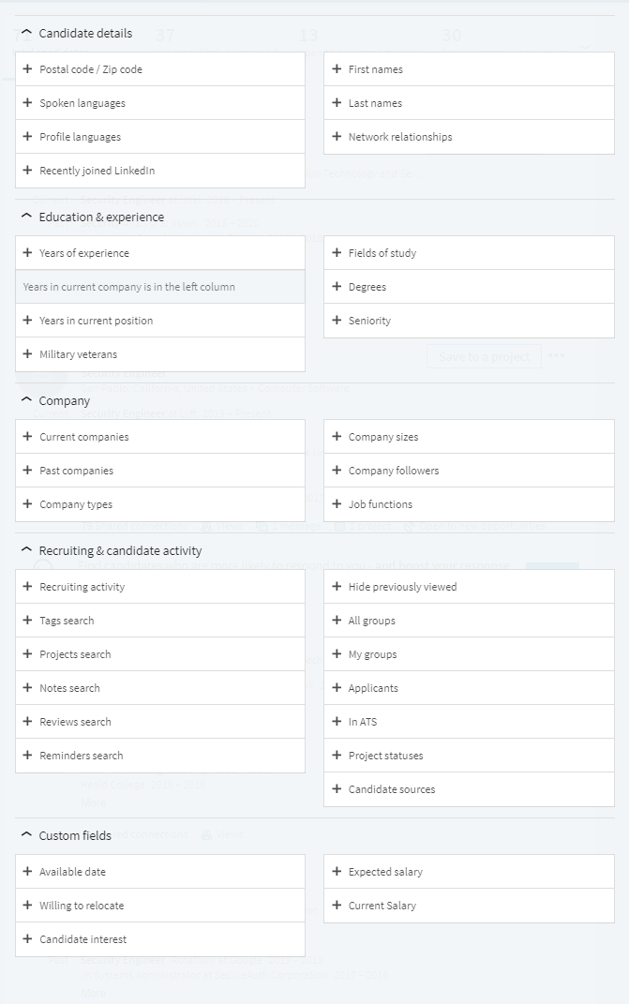
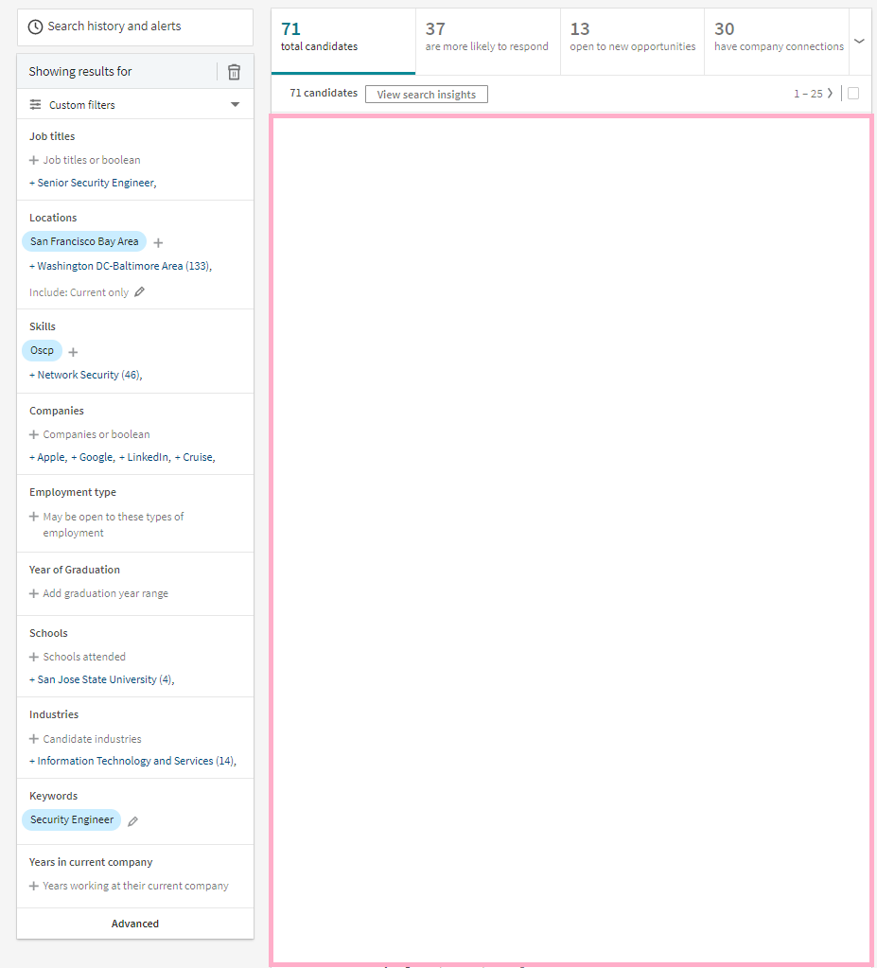
Search Results
have company connections
open to new opportunities
are more likely to respond
total candidates

Slide 22
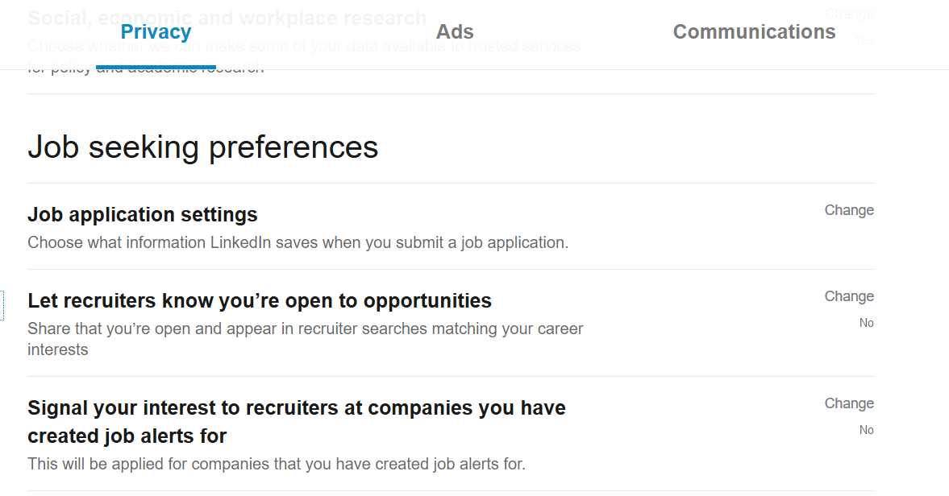
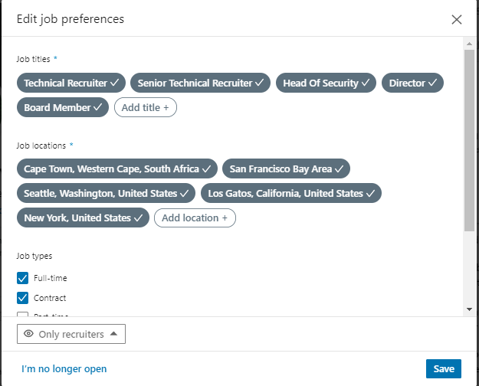
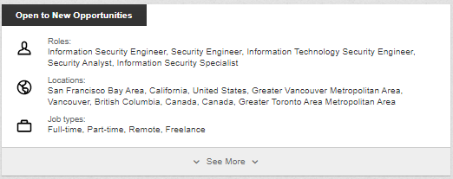
What Matters: Linked In/ Open To New Opportunities

Slide 23
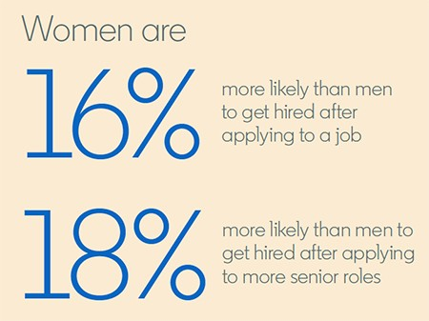
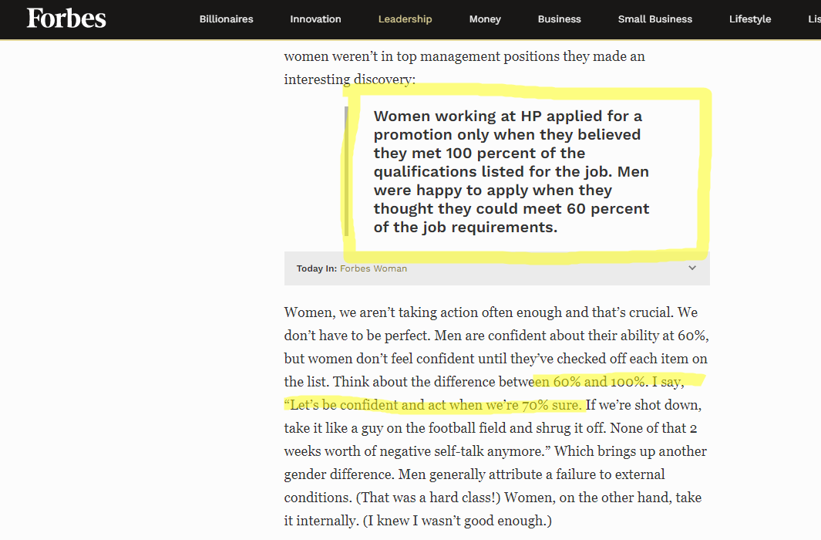
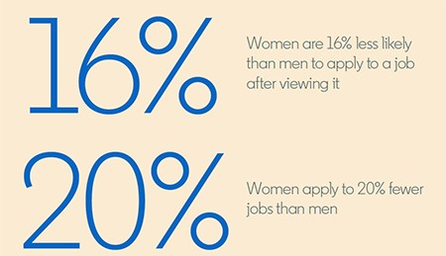
What Matters: Applications
What jobs do I apply for?
Job Description?
Are you interested in the job?
Understanding who wrote/built the job description
1 JD = 1 Job?
Do you believe in your heart of hearts you can do the job?
If its a reach, when do I go for it?
Notes:
NEXT UP INTERVIEWS

Slide 24
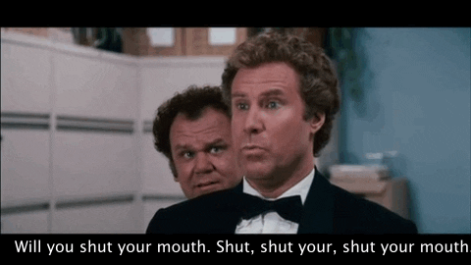
What Matters: Interviews
How does an interview go down?
Interview structures?
Treat every interview like it’s a dream job!
Research the company and the interviewers before hand
Don’t hack them
Don’t do an OSINT mission on them…like they have gone missing
Show your abilities, …. when asked to do so
Video Conference? Wear pants
Be yourself
REMEMBER (It’s a 2-way range!)
The company is interviewing you to see if you are suitable candidate for them, looking at
Technical Ability
Culture Fit
Background
You are interviewing the company to see
Will this job furfil my technical desires and challenge me?
Do I have a good manager and leadership?
Do I want to work with these people (Gen Company, peers and TM)?
Communicate with your recruiter
Notes:
Interview go down? Could be onsite from Interview 1 Usually is a call/webex/Zoom/Google Hangout Virtual Call + VM Environment + Monitoring Structure: Recruiter Recruiter POC TL TM Tech Test TPS ONSITE OFFER STAGE
Dream Job: You might regret not getting back to the recruiter *Comms with a recruiter:
*Keep them in the loop
*Different companies work in different ways
*Ask them Q’s?
*If they go silent, tip your hat!

Slide 25
What Matters: Tech Tests
You may be required to do a Tech Test/CTF
Prepare and plan for it being harder than you think
Hope it's easier than the above
Give it your everything!
Usually you will be asked to write a report
Tech tests can be anything including but not limited to:
3 x 12 hour CTF’s followed by 3 detailed reports
1 x 24 hour Full Scope CTF, followed by an executive report and a technical report
1 x 3 hour CTF on HTB/Vulnhub
30 Min challenge on Hackerrank.com
Notes:
Prepare: You can talk the talk, can you walk the walk

Slide 26

What Matters: Closing the deal
Points to consider before accepting a offer
Does the job fit my skills and abilities?
Does the company match my ethics/culture?
Do I get on with the team mates, line manager and higher ups?
The Offer
Short term gain?
Base Salary
Benefits
Perks
Travel/Location/Relocation
PSU/RSU, Equity, Stocks
Medium Term
What skills and exp will I gain in this position?
Long term gain
What value will this job bring to my career?
How will this title look on my resume/LinkedIn
What value does this add to my future?
MONEY TALK and agency recruiters
Accept/Decline
Notes:
Salary How long have I been in my current job
Pay bump
Relocation

Slide 27
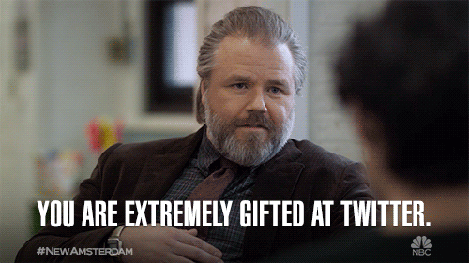
What Matters: Twitter
Get involved
Who to follow?
Follow the best
Follow the noobs
Ergo….Follow Value!!!
What not to do?
SEX
POLITICS
RELIGION
Dirty Laundry
Trolling
Notes:
Politics: I will not get involved with SA Politics

Slide 28

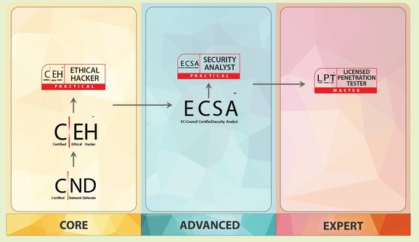



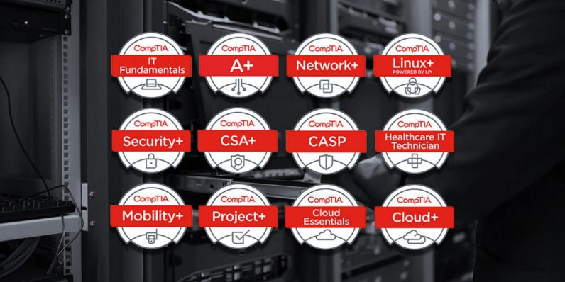
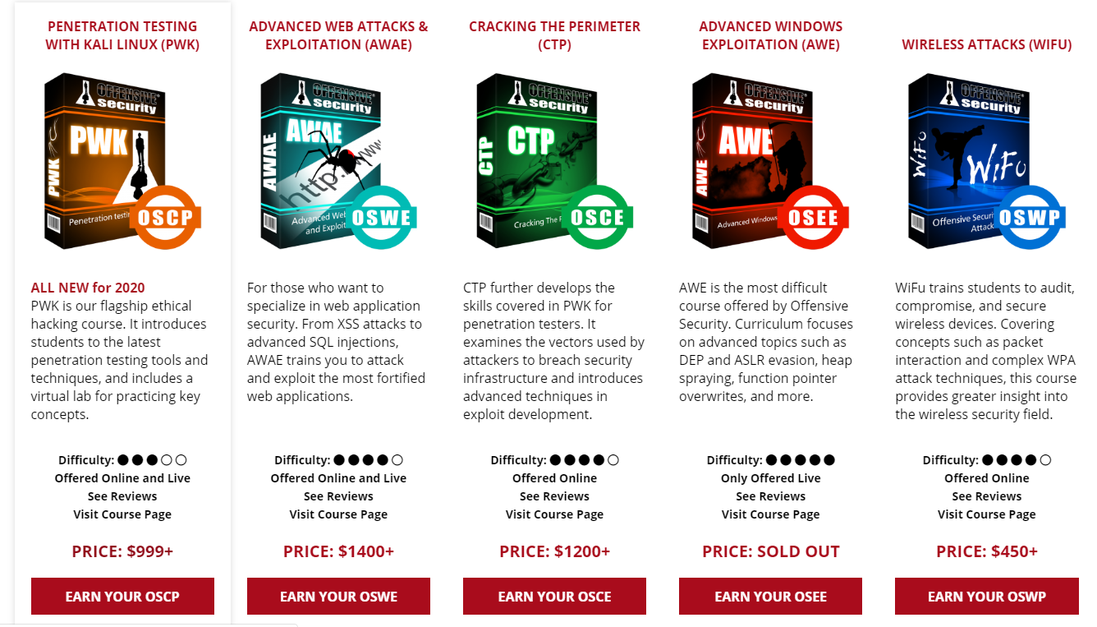

Certifications and Education
***AMBIGUITY WARNING***
Notes:
When do I do what course? Understand first what you are trying to achieve? What is the outcome you desire? Gain skill vs Gain piece of paper?
Are you trying to understand how to pass the cert, or are you working towards having that added skill set? Understand that, you will understand what course to do. Check with your current employer about educational reimbursement? $5000 If you dont or cant do a course, do what this guy does. Get a balaclava, make sure your CLI is green, and hack the planet.

Slide 29
I Recruit Hackers
Your career
Short term vs Long Term Career decisions

Slide 30
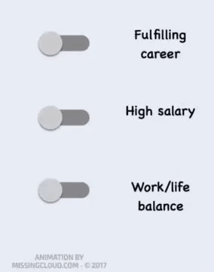


Your Career
Discussion
The MONEY
The JOB
The RESUME
Notes:
When making the decision to accept an offer with a new company it is CRUCIAL to understand 3 basic factors. Note that these 3 parts cross pollinate the others. A symbiosis if you will.
Short Term? Money in the bank, quality of living, medical cover, educational reimbursement etc etc
Mid Term-The Job: What is this job going to do for me? What skills will I learn. What ability will improve? What new challenges will I face and HOW WILL THIS AFFECT MY FUTURE.
The Long Term-YOUR RESUME: How will this look on my resume? What value does this bring to me. What happens if you take a high paying gig that slowly kills you inside, and then you quit? Do that too many times you kill your career as you become a risk hire.
If taking short term contracts, that is fine! Just label the gig as a contract.
When I was a contractor

Slide 31
I Recruit Hackers
Tips/Summary
As it says on the tin

Slide 32

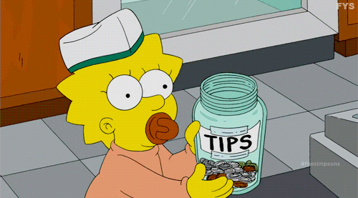
Tips and Summary
RECRUITER 101
Get involved with the community!
ABL
Help the less experienced and learn from those more experienced
Treat every job application process like it is your dream job.
If you trust your recruiter, talk money, BUT
Don't only think about the short-term gain, think about your career!
Don’t bypass your recruiter
Don’t hack the job
Notes:
Dealing with a Recruiter

Slide 33
Sources/Links
*FORBES article on gender based applications looking at how “Applicable” someone is toa Job Description
https://www.forbes.com/sites/womensmedia/2014/04/28/act-now-to-shrink-the-confidence-gap/
*LinkedIn: Women Apply to Fewer Jobs Than Men, But Are More Likely to Get Hired
https://business.linkedin.com/talent-solutions/blog/diversity/2019/how-women-find-jobs-gender-report
*GIPHY: Gifs
https://giphy.com/

Slide 34
I Recruit Hackers
Questions!
Speak now or forever hold your peace

Slide 35
Thanks!
@thatinfosecrec
@5w0rdFish
@TheManyHatsClub
@hack_south
@ZoomerX
@bufferOfStyx
@TheCyberViking
@rag_sec
@TJ_Null
@AlanTheBlank
Shella (Missus)
Mom and Dad, not @SecFenrir

Slide 36




I Recruit Hackers
@AngusRedBlue
@hack_south
https://github.com/AngusRed
/in/chwroth/
HTB User/195578
Socials
Find me!

